Slide 1
Group 4
Final Presentation
Sean Hansen
Ivan Guzman
Luis Gonzalez
Jose De Ita

Slide 2
Agenda:
Project Background
Project Tools/Services
Los Angeles Data Mining
Chicago Data Mining
Lessons Learned

Slide 3
Project Background
The cities of Los Angeles and Chicago both keep extensive databases on criminal activity, which are available through their respective city portals
The databases differ in several aspects, but in general each row represents a crime that occurred and describes the general attributes of the crime such as:
Date/time of occurrence
Crime type
Premise
Location
Other attributes specific to each city
The goals of our project are as follows:
Get a summarized view of crime activity in each city, including breakdowns by crime type/location as well as overall crime trends (e.g. Homicide rate increase/decrease per year)
Construct a data warehouse for each data set, and use each warehouse to construct a data cube in order to perform OLAP operations
Analyze relationships between crime attributes, e.g. premise type & victim sex -> crime type
Create a unified dataset using attributes common to both cities to view them side by side

Slide 4
Project Tools/Services
Cleaning/Preprocessing
Performed by a combination of:
Python (Pandas)
R
Data storage
MS SQL Server
AWS Instance
Our Local Machines
Analysis Server/OLAP
MS SQL Server Analysis Services
Visualization/Documentation
Jupyter Notebook
Matplotlib

Slide 5
LA Preprocessing
#open ipython notebook

Slide 6
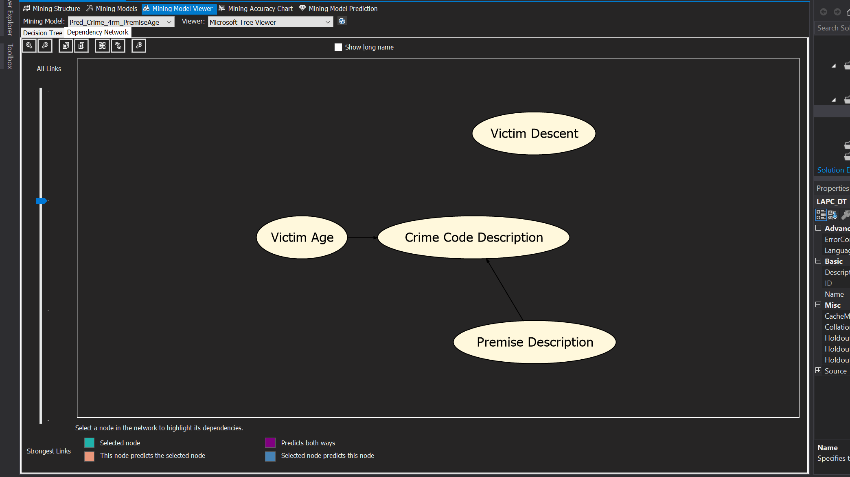
D.T. Predict Crime
Inputs: Premise,Age,Descent
Relation: Premise>Age>Descent
Results: Inconclusive, not interesting

Slide 7
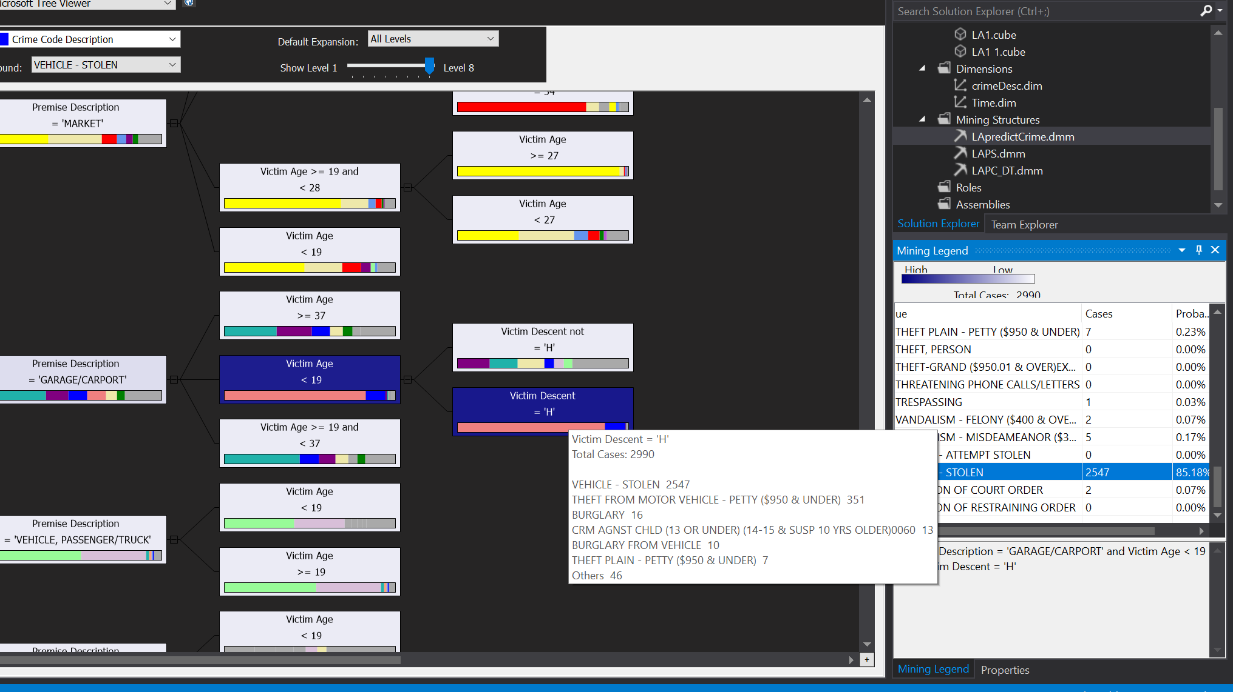
D.T. Predict Crime Cont. (Garage)

Slide 8
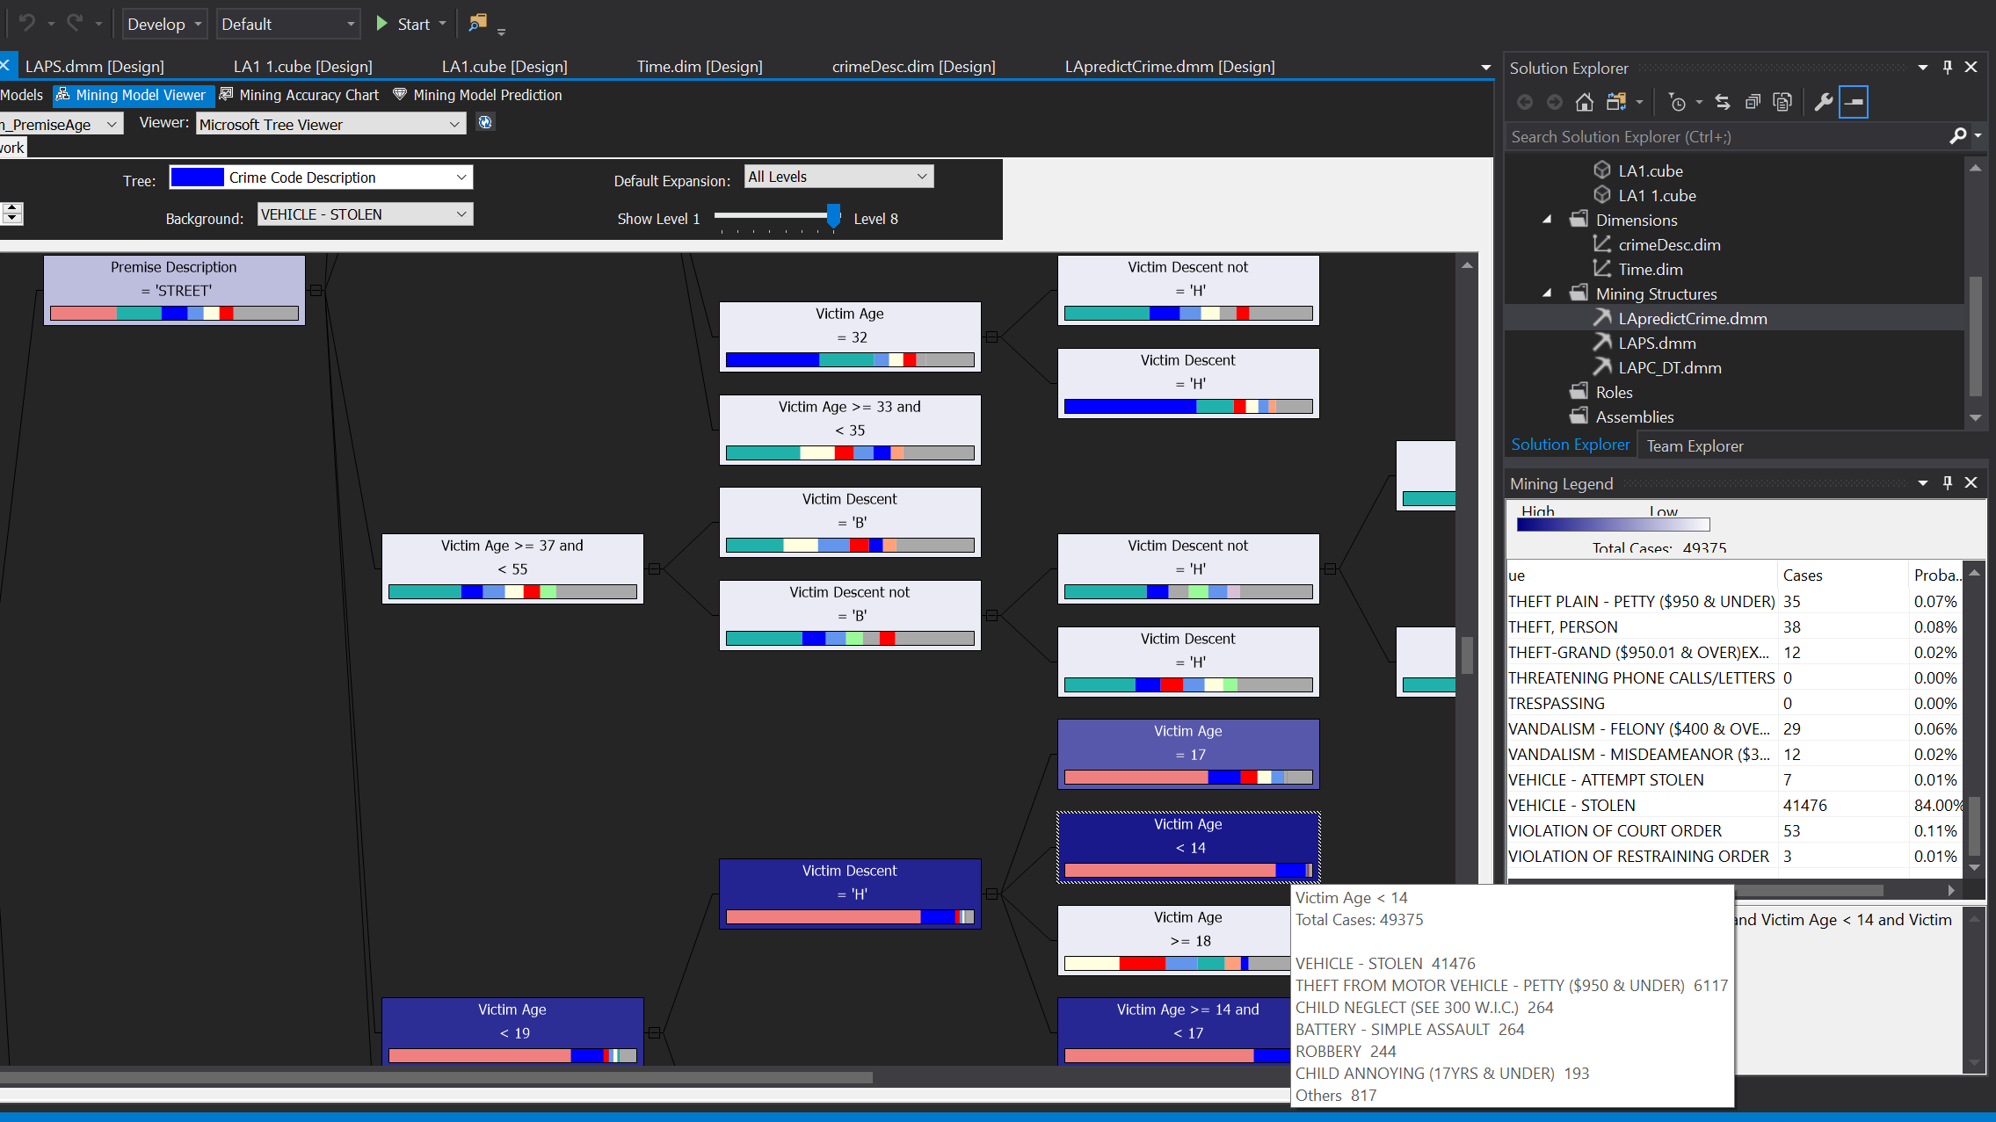
D.T. Predict Crime Cont. (Street)

Slide 9
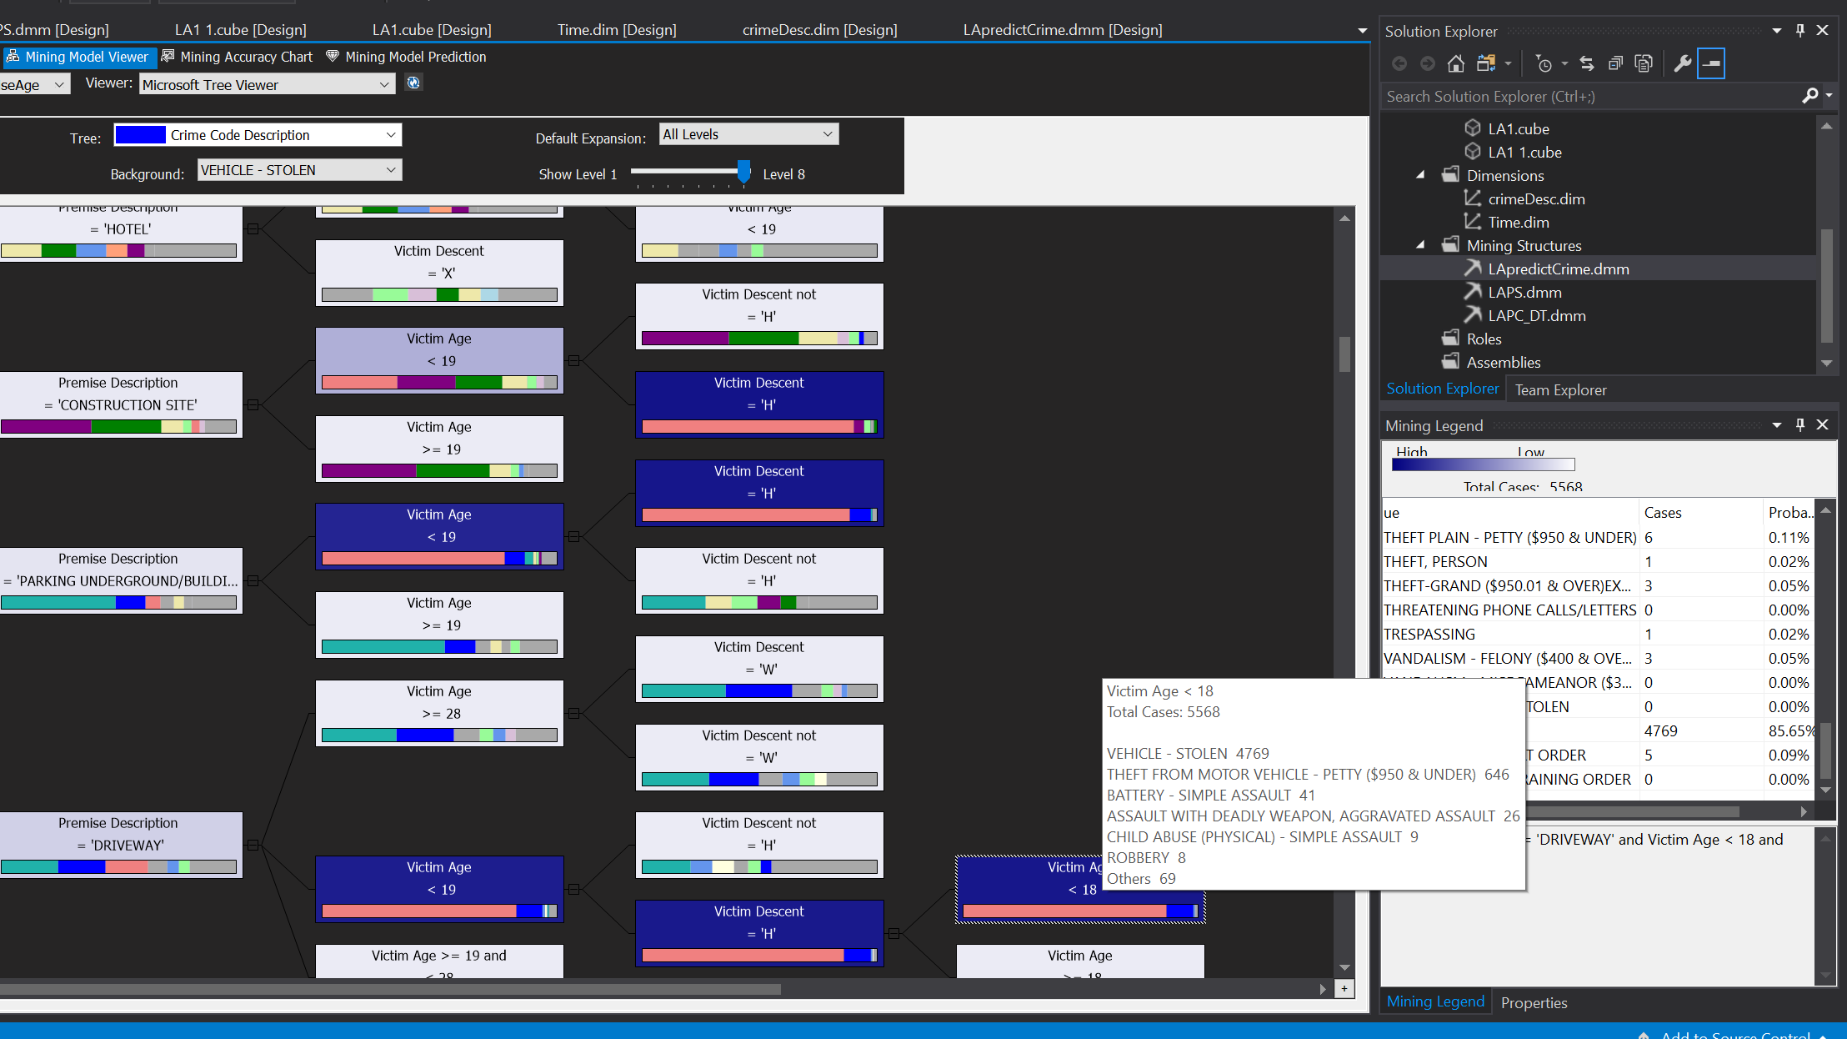
D.T. Predict Crime Cont. (Driveway/Parking)

Slide 10
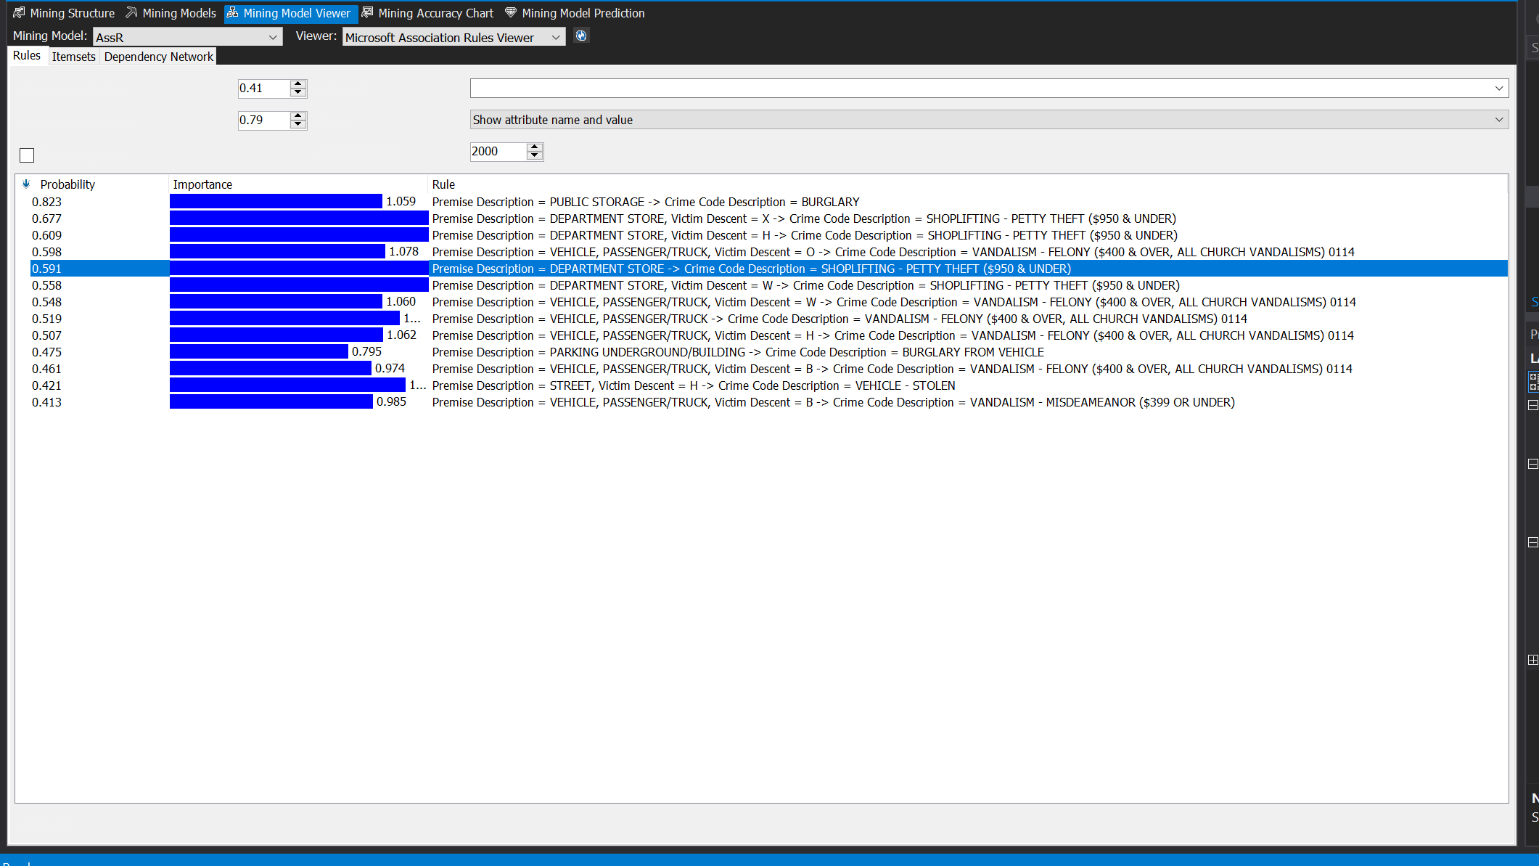
Association Rules Viewer

Slide 11
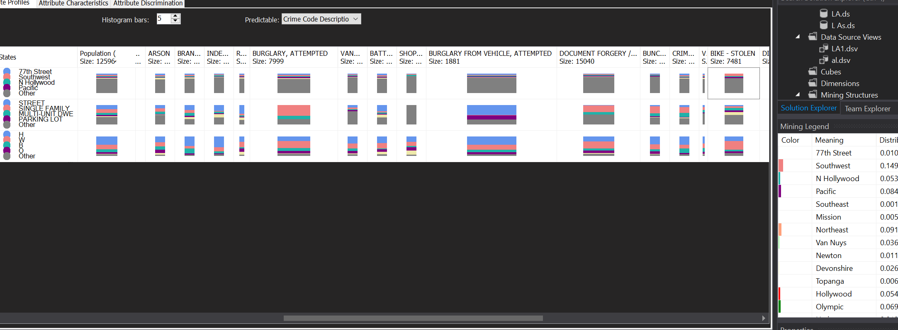
MS Naive Bayes Viewer Attribute Profiles

Slide 12
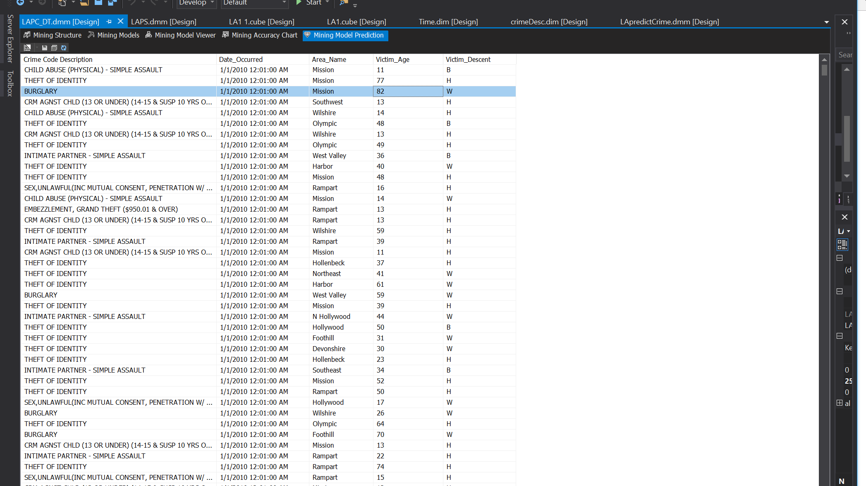
Predictions from Decision Tree

Slide 13
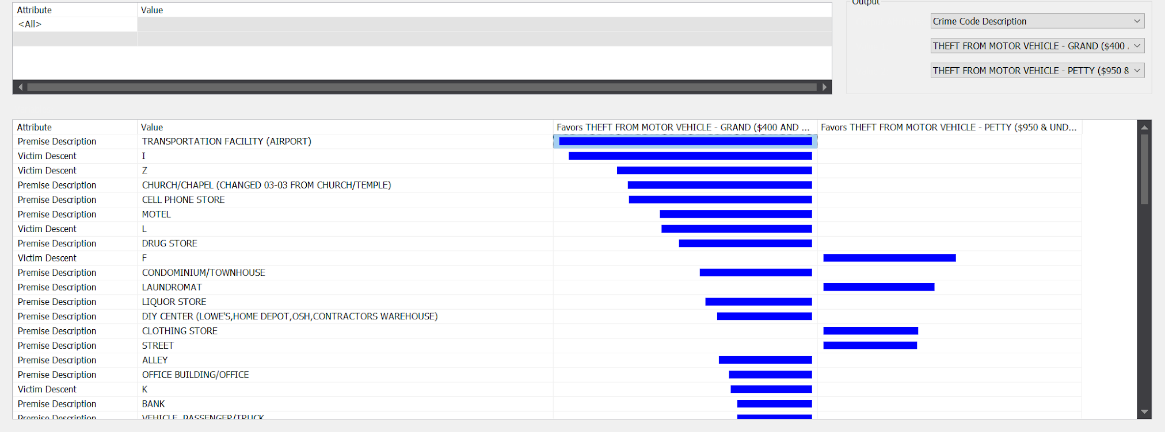
Neural Network (Grand V. Petty Car Theft)

Slide 14
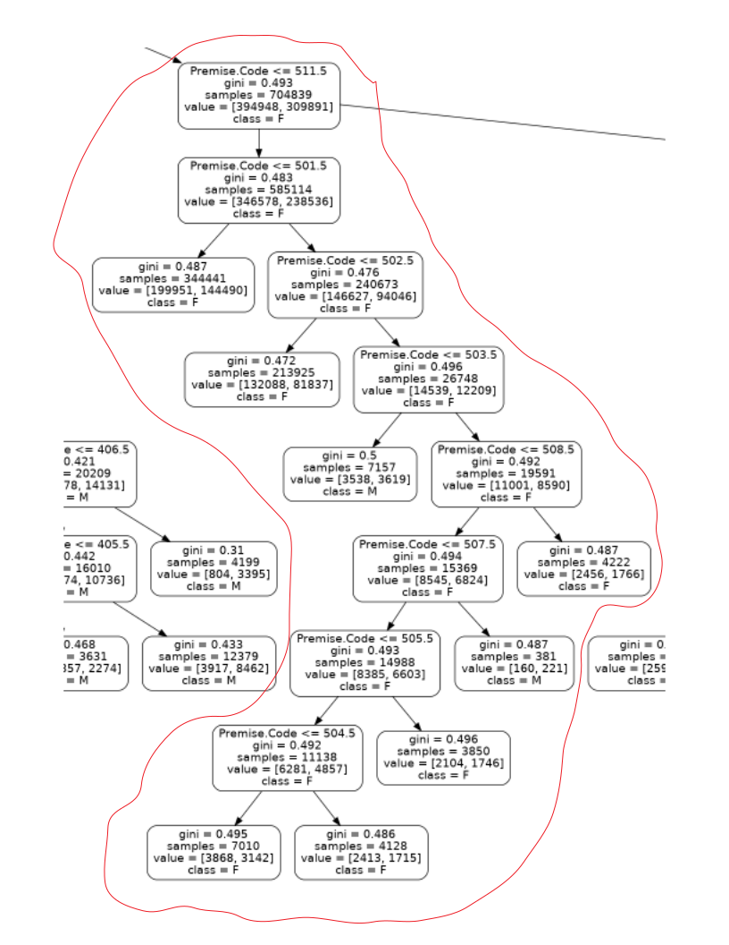
Los Angeles Decision Tree
501
This subtree is of some interest, it seems that women are the most common victims of crimes that occur at residences
Premise Codes:
501 - SINGLE FAMILY DWELLING
502 - MULTI-UNIT DWELLING (APARTMENT DUPLEX ETC)
503 - HOTEL
504 - OTHER RESIDENCE
505 - MOTEL
506 - ABANDONED BUILDING ABANDONED HOUSE
507 - CONDOMINIUM/TOWNHOUSE
509 - MOBILE HOME/TRAILER/RV/MOTORHOME
502
509
506
504
505

Slide 15
LA Matplot Graphs
#open other notebook

Slide 16
Chicago Dataset
Preprocessing
Raw data stored in CSV format
Unaltered data set contains ~6.5 million rows with 21 attributes
Removed Attributes 10 attributes to reduce the curse high dimensionality
Example Attributes;
ID (Primary Key) - Integer
Date & Time
Primary Crime Type - String
Crime Description - String
Location Description - String
Arrest Made - Boolean

Slide 17
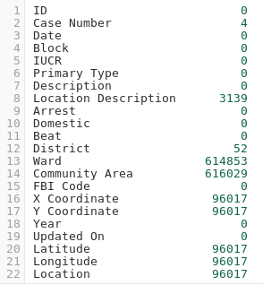
Cleaning: Missing Values
Chicago Dataset
Most commonly missing values:
Ward/Community Area
Ward can be derived from beat, community area can be derived from ward
Location Description
Most of the time when this value is missing, it is because the crime is some type of computer crime (identity theft, unauthorized computer use, etc.) where the location is not easily identified
Filled in missing values with ‘UNKNOWN’
District
We derived the missing districts from the beat, which is never missing

Slide 18
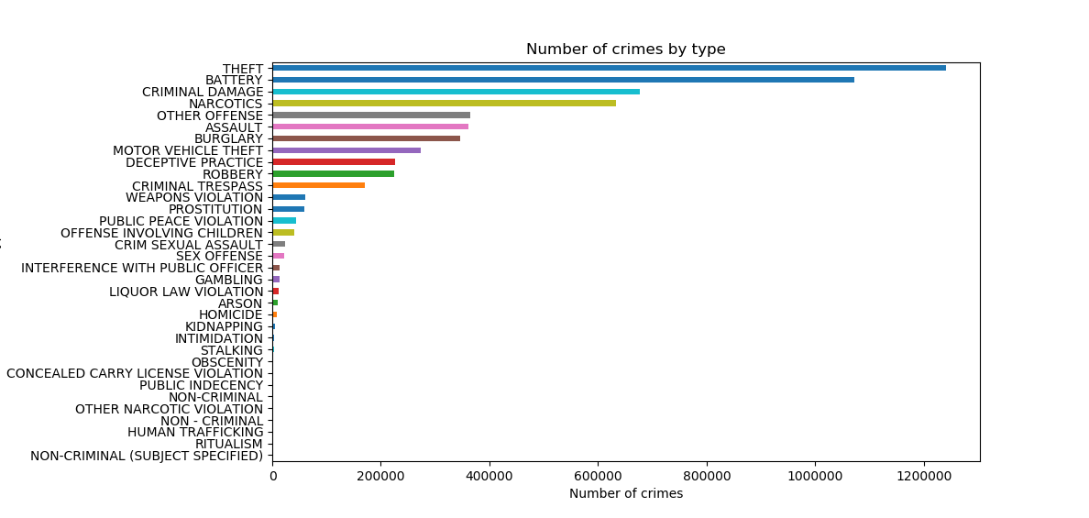
Chicago Dataset
Crime Visualizations

Slide 19
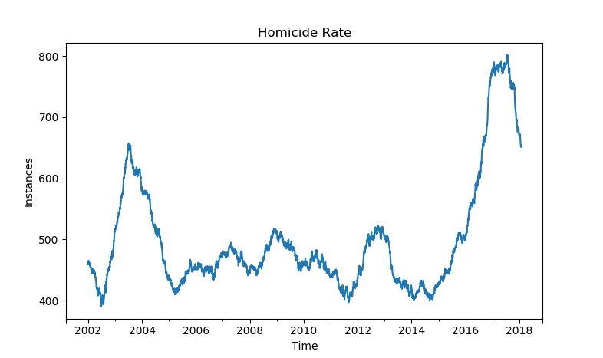
Chicago Dataset
Crime Visualizations Cont.

Slide 20
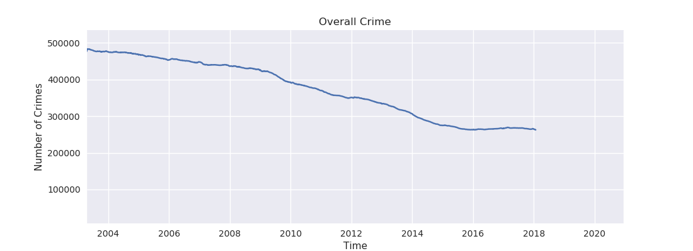
Chicago Dataset
Crime Visualizations Cont.

Slide 21
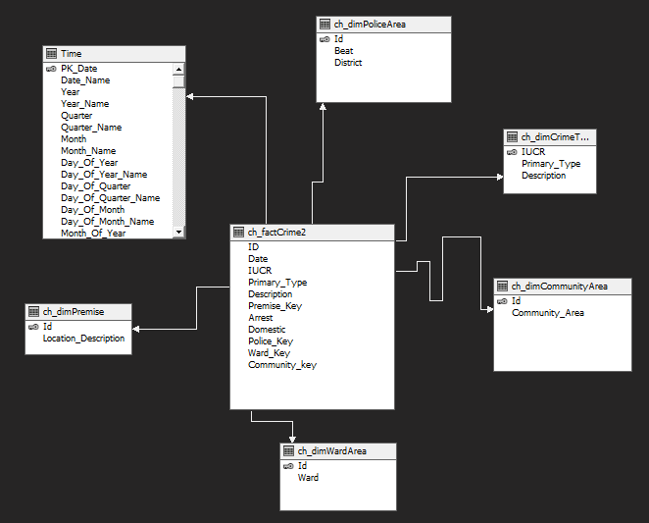
Chicago Data Warehouse
Construction / Design
Data Warehouse stored in MS SQL Server 2016 Database
Simple star schema, with one fact table ‘ch_factCrime2’.
6 dimension tables:
ch_dimTime
ch_dimPoliceArea
ch_dimCommunityArea
ch_dimCrimeType
ch_dimWardArea
ch_dimPremise
Measure: Count of Rows

Slide 22
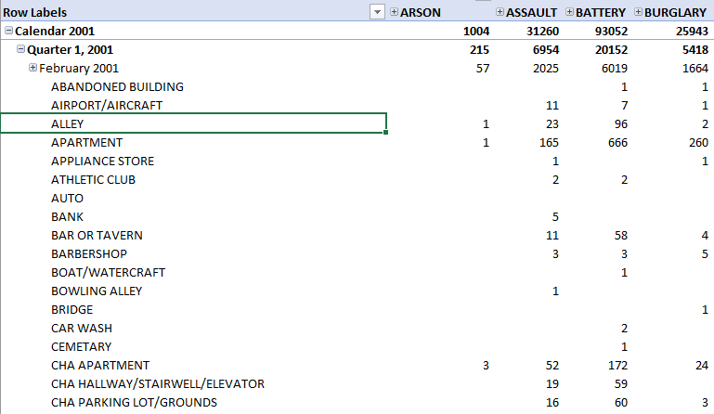
Chicago Crime Data Cube
Sample OLAP: Drill Down/Dice
Cuboid Depicted:
Dimensions used:
Time
Premise
Crime Type
OLAP Operations:
Drill Down Time from ‘All’ -> ‘Year’ -> ‘Quarter’ -> ‘Month’
Drill Down Crime Type from ‘All’ -> ‘Primary Type’
Slice CrimeType = ARSON or ASSAULT or BATTERY or BURGLARY and Month = February 2001

Slide 23
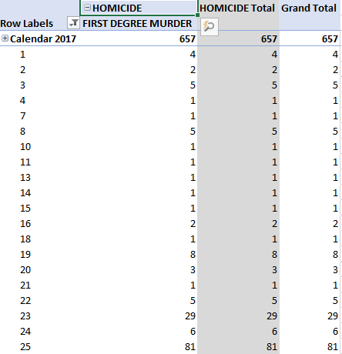
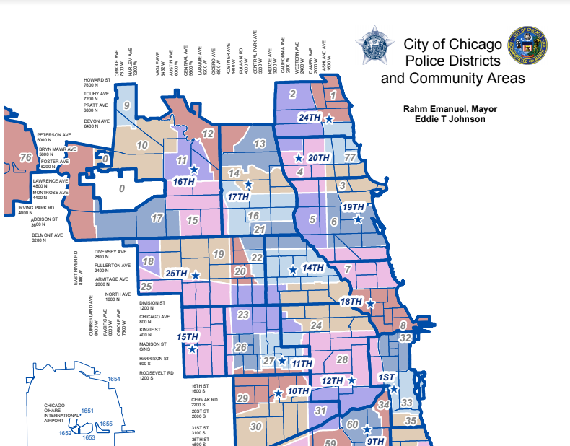
Chicago Crime Data Cube Sample OLAP
Which community area had the highest homicide rate in 2017?

Slide 24
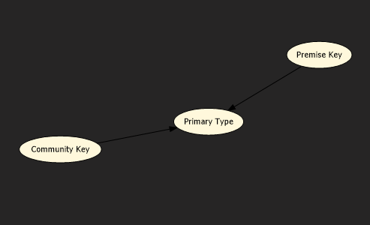
Chicago Data Warehouse
Decision Tree Design
We attempted to keep the # of attributes used to predict crime type low, due to the categorical nature of our data
Even using this very simple mining structure depicted to the right results in 44 tree levels , and borders on being too large to view in its entirety. It also takes ~15 minutes to build

Slide 25
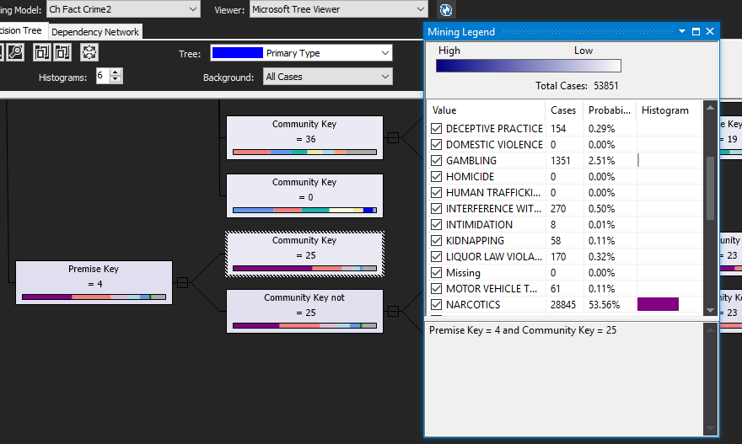
Chicago Data Warehouse
Decision Tree Example
Example Decision Tree:
Attributes:
Community Area
Premise
Prediction:
Crime Type
Description:
Premise Key = 4 (SIDEWALK)
Community Key = 25 (Austin)
If you recall, this was the area with the highest murder rate in 2017
Conclusion:
Narcotics (~53%)

Slide 26
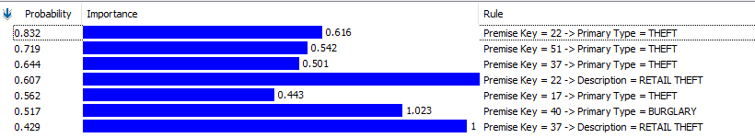
Chicago Data Warehouse
Association Rules
Premise Key = 22 | DEPARTMENT STORE
Premise Key = 51 | DRUG STORE
Premise Key = 37 | GROCERY FOOD STORE
Premise Key = 17 | SMALL RETAIL STORE
Premise Key = 40 | RESIDENCE-GARAGE

Slide 27
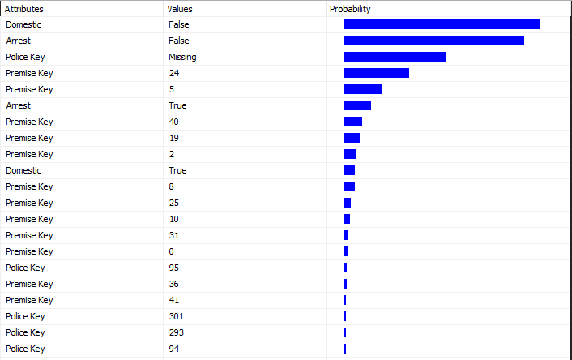
Chicago Data Warehouse
Naive Bayes Classifier - Attribute Characteristics

Slide 28
Lessons Learned and Future Work
Highly discrete/nominal data sets such as ours do not lend themselves very well to certain data mining techniques such as decision trees, which seem to favor continuous data
SSAS, while useful, is more oriented towards traditional business intelligence and business-like data. This made it difficult at times to adapt to our data
‘Dirty data’ can be difficult to spot, and can take several iterations/methods of cleaning to notice
An example of this in our data is vehicle theft, where ~85% of examples contained inconsistent victim data
AWS RDS, which we used to store our MS SQL instance, is significantly less powerful in terms of privileges compared to a normal instance which gave us service integration issues
Overall, crime in both cities trends downwards over these time periods, especially when it comes to violent crimes, with the exception of homicide in Chicago

